Slide 1
Homotopic Morphing of Planar Curves
Nadav Dym, Anna Shtengel and Yaron Lipman
Weizmann Institute of Science

Slide 2



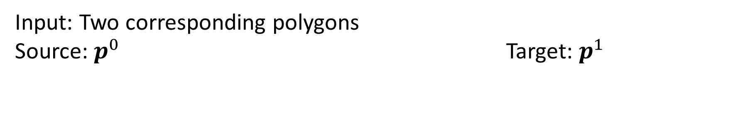
Morphing of planar curves
Input: Two corresponding polygons
Source: $p^{0}$ Target: $p^{1}$
Output: An animation sequence $p^{t}, t∈[0,1]$.

Slide 3
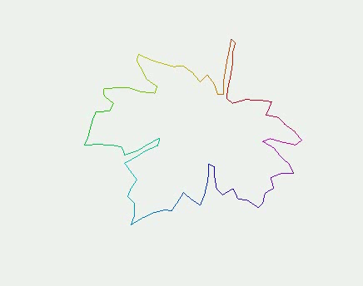
This is how it looks

Slide 4
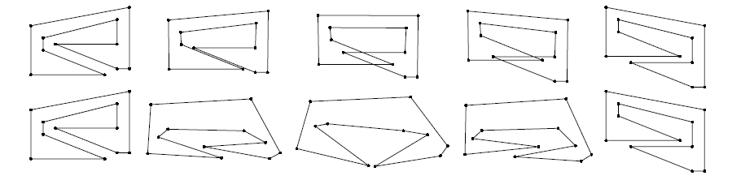
Guaranteed morphing: Global intersection prevention
[Iben et al. 2009], [Gotsman and Surazhsky 2001]
[Iben et al. 2009]

Slide 5
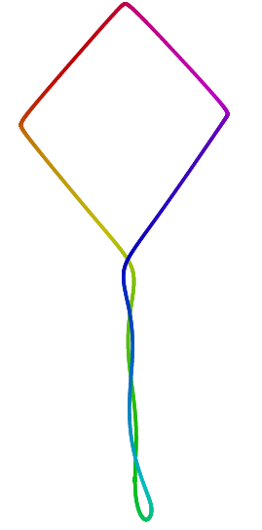
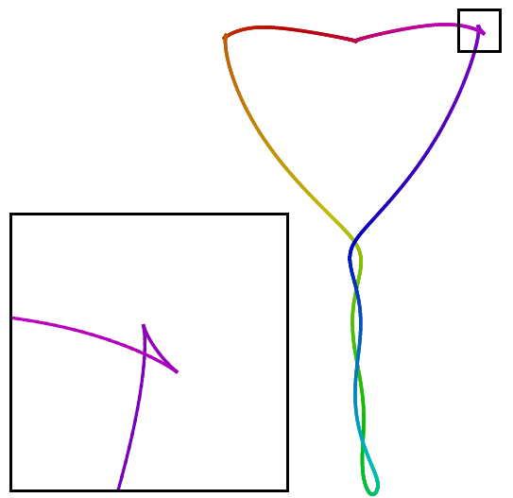
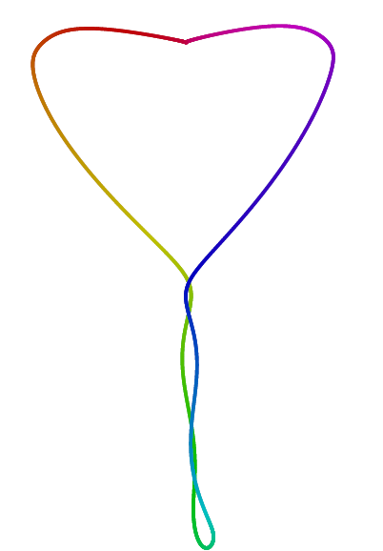

Our Goal: Local intersection prevention (Regular homotopy)
angle-length
ours

Slide 6
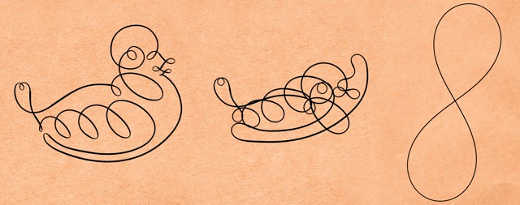
Same guarantees-different problem
Robust Fairing [Crane et al. 2013]: Regular homotopic fairing

Slide 7
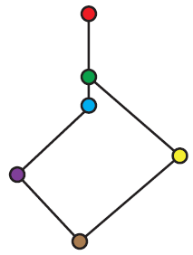
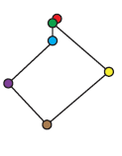

Regular polygons
$p=\left[p_{0},p_{1},…,p_{n} =p_{0}\right]$ is regular if:
No local intersections
2. No degenerate edges

Slide 8
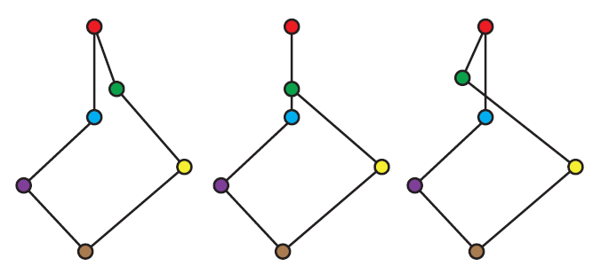
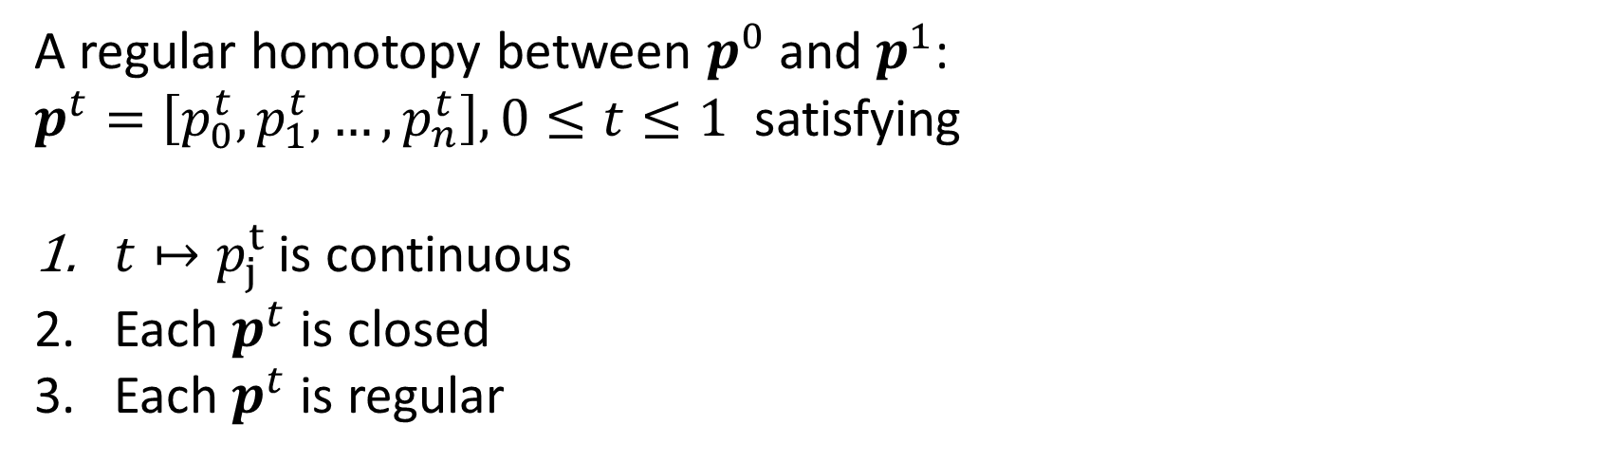
Regular homotopy: Definition
A regular homotopy between $p^{0}$and $p^{1}$:
$p^{t}=\left[p_{0}^{t},p_{1}^{t},…,p_{n}^{t}\right], 0≤t≤1$ satisfying
$t↦p_{j}^{t}$ is continuous
Each $p^{t}$ is closed
Each $p^{t}$ is regular
non-regular

Slide 9
Is regular homotopy always possible?
Is regular homotopy possible for the example above?
non-regular homotopy

Slide 10
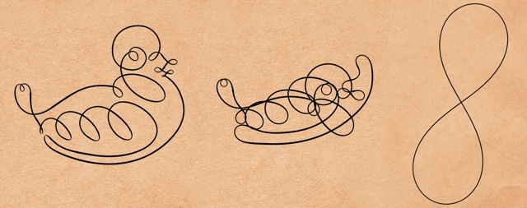
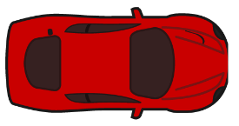




Turning number
Turning number: The angle accumulated by the tangent field when traversing the curve
$$τ=−1$$
$$τ=0$$
$$τ=1$$
$$τ=2$$

Slide 11
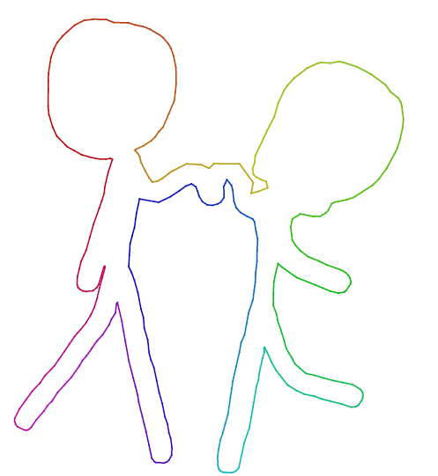

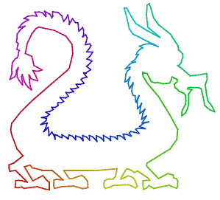




Often $τ\left(p^{0}\right)=τ\left(p^{1}\right)=1$
(e.g., simple curves)
$$τ=1$$
$$τ=1$$
$$τ=1$$

Slide 12

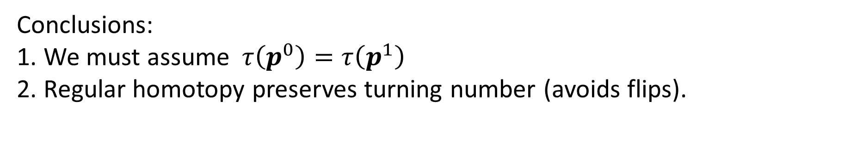
Theorem (Whitney-Graustein)
Regular homotopy
$$τ\left(p^{0}\right)=τ(p^{1})$$
Conclusions:
1. We must assume$τ\left(p^{0}\right)=τ\left(p^{1}\right)$
2. Regular homotopy preserves turning number (avoids flips).

Slide 13


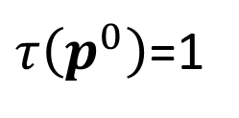
Regular homotopy impossible when $τ\left(p^{0}\right)≠τ(p^{1})$
$τ\left(p^{0}\right)$=1
$$τ\left(p^{1}\right)=0$$

Slide 14

Our Goal:
Regular Homotopic Morphing
No local intersections, degenerate edges
Aesthetic animation
✗
✗

Slide 15
Main result
Guaranteed regular homotopic morphing.
Obtained by (more details later):
Convex representation of the space of regular curves
Choosing optimal regular curve with respect to fitting energy

Slide 16

Limitation: Our theoretical guarantees don’t apply when
$$τ\left(p^{0}\right)=τ\left(p^{1}\right)=0$$

Slide 17
Method

Slide 18
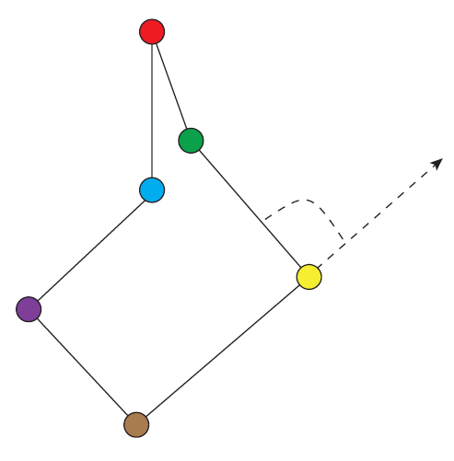
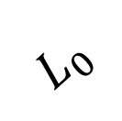





Intrinsic coordinates
Edge lengths: $L_{j}={||p}_{j+1}−p_{j}|{\left.​\right|}_{2}$
Exterior angles: $θ_{j}$
Intrinsic: Preserved under rigid motions
$$p_{2}$$
$$θ_{1}$$
$$p_{1}$$
$$L_{0}$$
$$p_{0}$$

Slide 19
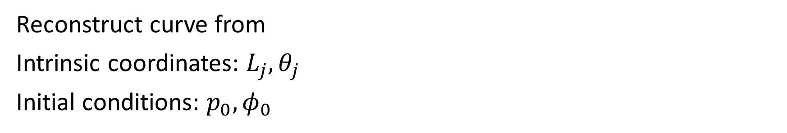
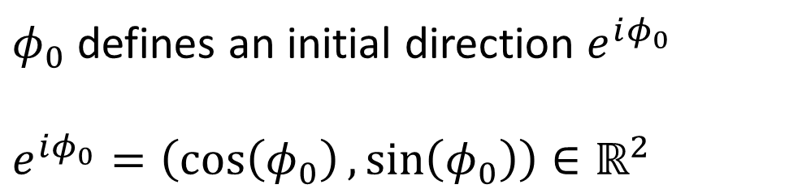
Reconstruction from intrinsic coordinates
Reconstruct curve from
Intrinsic coordinates: $L_{j},θ_{j}$
Initial conditions: $p_{0},φ_{0}$
$$p_{2}$$
$$θ_{1}$$
$$p_{1}$$
$φ_{0}$ defines an initial direction $e^{iφ_{0}}$
$$e^{iφ_{0}}=\left(\cos\left(φ_{0}\right),\sin\left(φ_{0}\right)\right)∈ℝ^{2}$$
$$L_{0}$$
$$p_{0}$$

Slide 20
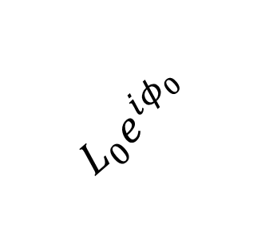







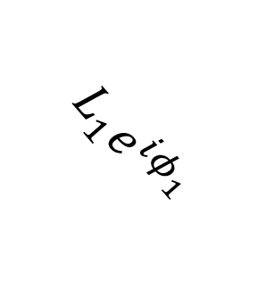
Curve reconstruction
$$p_{2}$$
Reconstruct curve from
$L_{j},θ_{j},p_{0},φ_{0}$
$$L_{1}e^{iφ_{1}}$$
$$φ_{1}=φ_{0}+θ_{1}$$
$$θ_{1}$$
$$φ_{2}=φ_{1}+θ_{2}$$
$$p_{1}$$
$$L_{0}e^{iφ_{0}}$$
…
Terms we met earlier, in these coordinates:
$$p_{0}$$

Slide 21
Closing condition
$∑L_{j}e^{iφ_{j}}=0$
$$p_{2}$$
$$L_{1}e^{iφ_{1}}$$
$$θ_{1}$$
$$p_{1}$$
$$L_{0}e^{iφ_{0}}$$
$$p_{0}$$

Slide 22
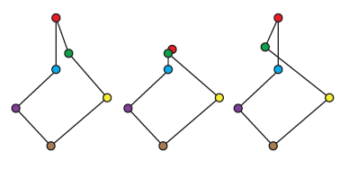



Regular polygonal curves
$$\left|θ_{j}\right|=π$$
$p$is regular if and only if:
No local intersections
${ (|θ}_{j}|<π$)
2. No degenerate edges
$(L_{j}>0)$
$$L_{j}=0$$

Slide 23
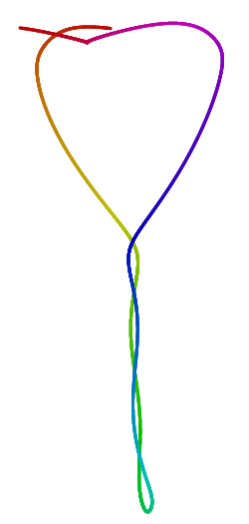
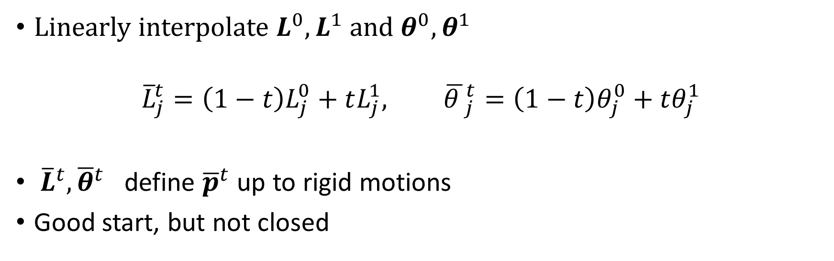
Angle-length method [Sederberg et al. 1993]
Linearly interpolate $L^{0},L^{1}$ and $θ^{0},θ^{1}$
$${\overline{L}}_{j}^{t}=\left(1−t\right)L_{j}^{0}+tL_{j}^{1}, {\overline{θ }}_{j}^{t}=\left(1−t\right)θ_{j}^{0}+tθ_{j}^{1}$$
${\overline{L}}^{t},{\overline{θ}}^{t}$ define ${\overline{p}}^{t}$ up to rigid motions
Good start, but not closed

Slide 24

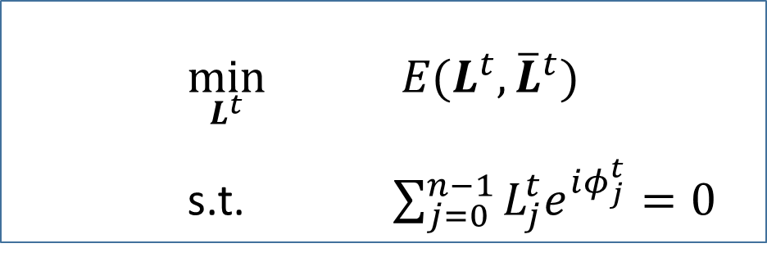
Angle-length method [Sederberg et al. 1993]
Keep ${\overline{θ}}^{t}$
For given $t,$find closest lengths to ${\overline{L}}^{t}$ which close the curve
$$\min_{L^{t}}{ E(L^{t},{\overline{L}}^{t})}$$
s.t.$\sum_{j=0}^{n−1}{L_{j}^{t}e^{iφ_{j}^{t}}=0}$
Convex problem

Slide 25
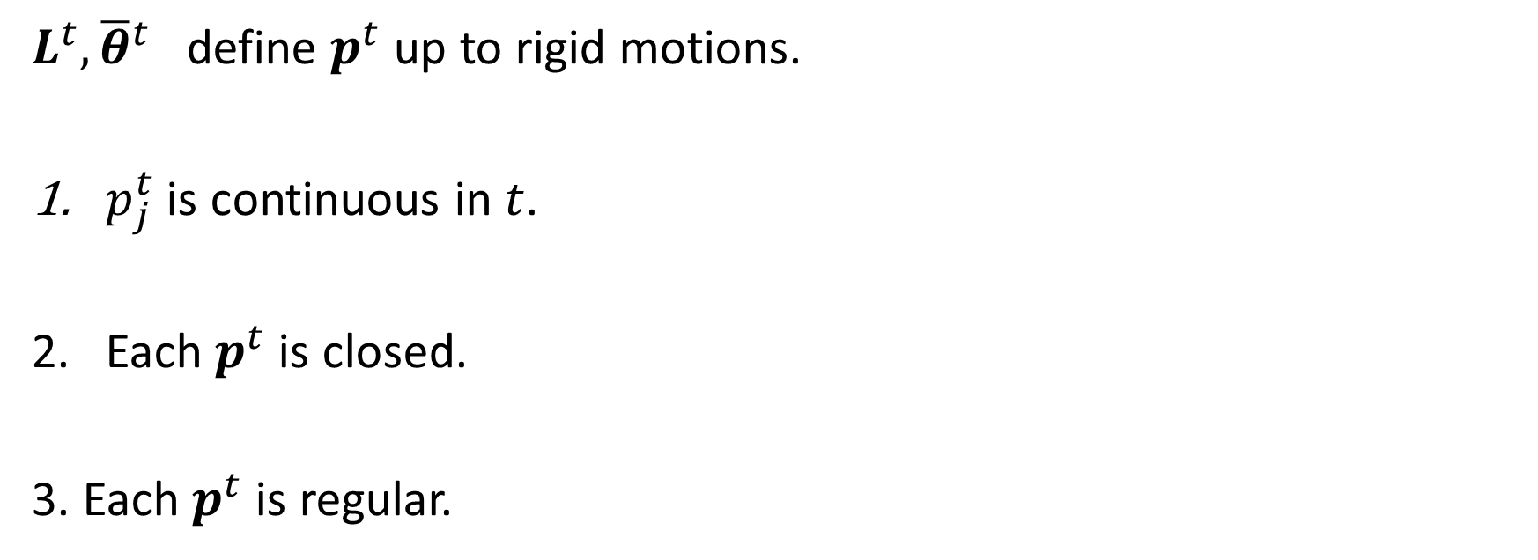


$L^{t},{\overline{θ}}^{t}$ define $p^{t}$ up to rigid motions.
$p_{j}^{t}$ is continuous in $t$.
Each $p^{t}$ is closed.
3. Each $p^{t}$ is regular.
✓
$$∑L_{j}^{t}e^{iφ_{j}^{t}}=0$$
✓
${|θ}_{j}^{t}|<π$and $L_{j}^{t}>0$
✓
✗

Slide 26

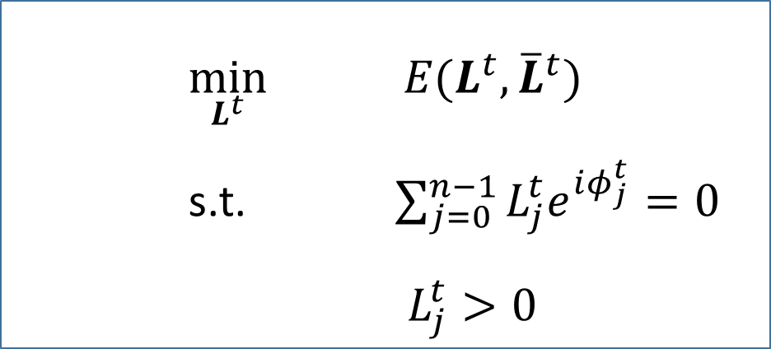
Our method
$$\min_{L^{t}}{ E(L^{t},{\overline{L}}^{t})}$$
s.t.$\sum_{j=0}^{n−1}{L_{j}^{t}e^{iφ_{j}^{t}}=0}$
$L_{j}^{t}>0$
Questions: 1. Feasibility?
2. What energy? How to deal with open constraint?
3. Is $t↦L^{t}$ well defined, continuous?

Slide 27
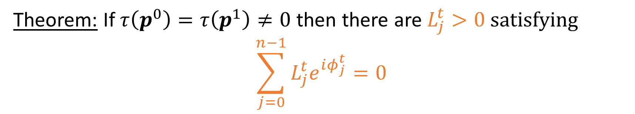
Feasibility theorem
Theorem: If $τ\left(p^{0}\right)=τ\left(p^{1}\right)≠0$ then there are $L_{j}^{t}>0 satisfying$
$$\sum_{j=0}^{n−1}{L_{j}^{t}e^{iφ_{j}^{t}}=0}$$

Slide 28

Choosing an energy
$$E\left(L_{}^{t},{\overline{L}}_{}^{t}\right)={\sum_{j=0}^{n−1}{\left(\frac{L_{j}^{t}−{\overline{L}}_{j}^{t}}{\sqrt{L_{j}^{t}{\overline{L}}_{j}^{t}}}\right)}}^{2}\frac{L_{j}^{t}+{\overline{L}}_{j}^{t}}{2}$$
Relative error
Length element

Slide 29

Regrouping:
$$E\left(L_{}^{t},{\overline{L}}_{}^{t}\right)=\frac{1}{2}\sum_{j=0}^{n−1}{\frac{1}{{\overline{L}}_{j}^{t}}{{(L}_{j}^{t})}^{2}−L_{j}^{t}−{\overline{L}}_{j}^{t}+{\left({\overline{L}}_{j}^{t}\right)}^{2}\frac{1}{L_{j}^{t}}}$$
Explodes as $L_{j}^{t}$ approaches zero
Strictly convex on $\left\{L^{t}\right| L_{j}^{t}>0\}$. Unique minimizer

Slide 30
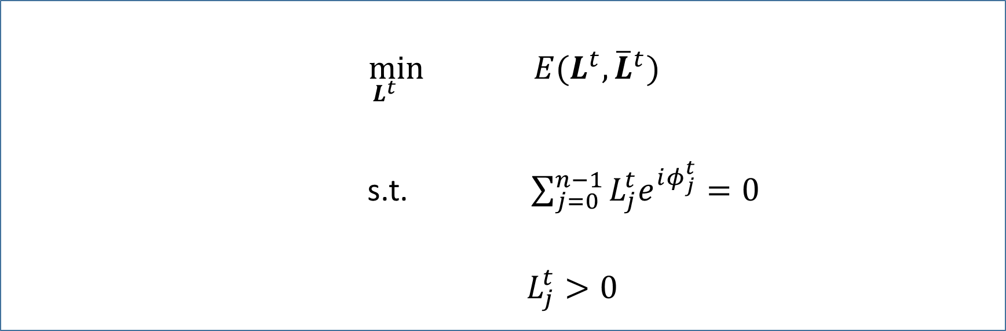

Dealing with the open constraint
$$\min_{L^{t}}{ E(L^{t},{\overline{L}}^{t})}$$
s.t. $\sum_{j=0}^{n−1}{L_{j}^{t}e^{iφ_{j}^{t}}=0}$
$L_{j}^{t}>0$
$$L_{j}^{t}≥0$$

Slide 31

Optimization
$$\min_{L^{t}}{ E(L^{t},{\overline{L}}^{t})}$$
s.t. $\sum_{j=0}^{n−1}{L_{j}^{t}e^{iφ_{j}^{t}}=0}$
$L_{j}^{t}≥0$
Second order cone programming.
Available solvers (e.g., Mosek)

Slide 32
Well defined, continuous
$t↦L^{t}$ is well defined since there is a unique minimizer
Theorem: $t↦L^{t}$ is $C^{∞}$
Smooth vertex path

Slide 33

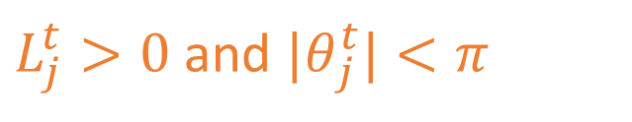

Mission accomplished
$L^{t},{\overline{θ}}^{t}$define $p^{t}$ up to rigid motions. Regular homotopy?
1. $p_{j}^{t}$ is continuous in $t$.
2. Each $p^{t}$ is closed.
3. Each $p^{t}$ is regular.
✓
$$∑L_{j}^{t}e^{iφ_{j}^{t}}=0$$
✓
$L_{j}^{t}>0$ and ${|θ}_{j}^{t}|<π$
✓

Slide 34
Summary: Main result
We showed how an optimal regular homotopy can be found by convex optimization over the space of regular curves.
Let’s see some examples:

Slide 35


Slide 36
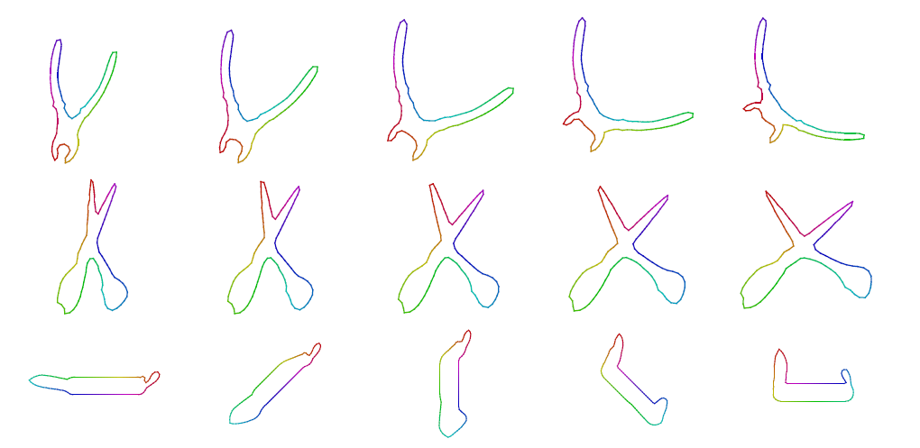

Slide 37
Comparison with angle-length
angle-length
ours

Slide 38
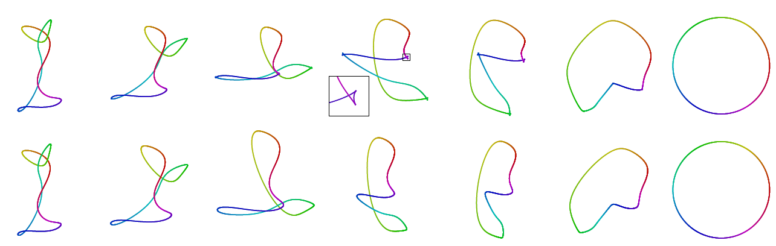
angle-length
ours

Slide 39
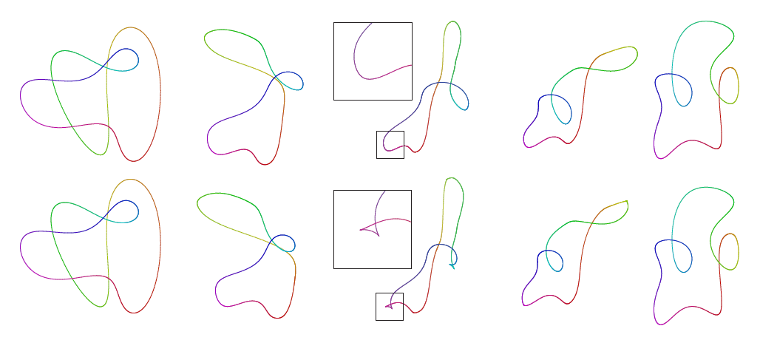
ours
angle-length

Slide 40
Additional results: Briefly

Slide 41
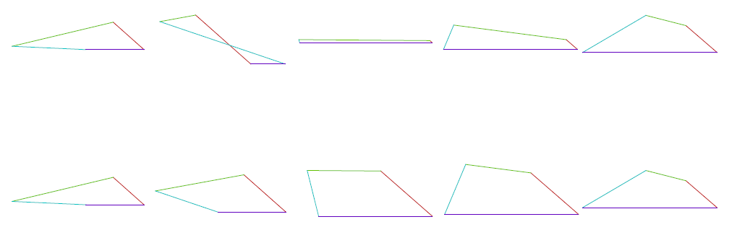
Convex morphing
angle-length
ours

Slide 42
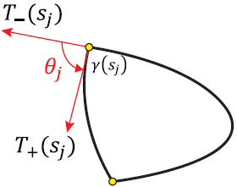
Morphing piecewise smooth curves
Special cases: Polygons, smooth curves
For smooth curves:
Modification of curvature interpolation methods
[Surazhsky and Elber 2002], [Saba et al. 2014]

Slide 43
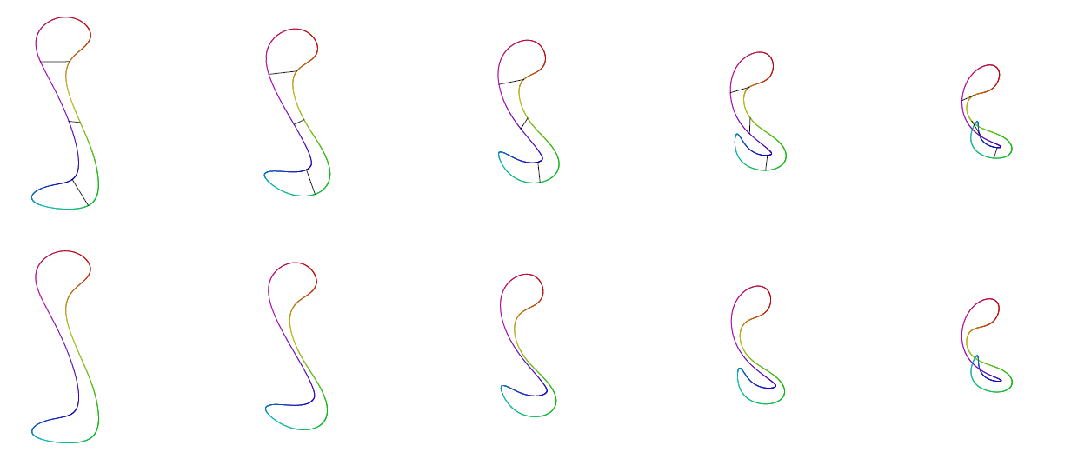
Partial extension to polygon mesh morphing

Slide 44
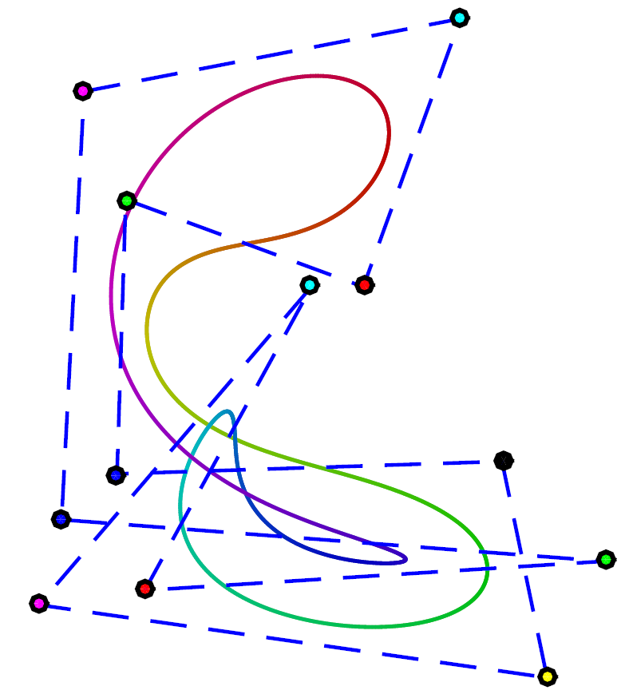
Homotopic morphing of b-spline curves
Can we homotopically morph b-spline curves by morphing their control polygons?
Not always.
We give an easily checkable sufficient condition.

Slide 45
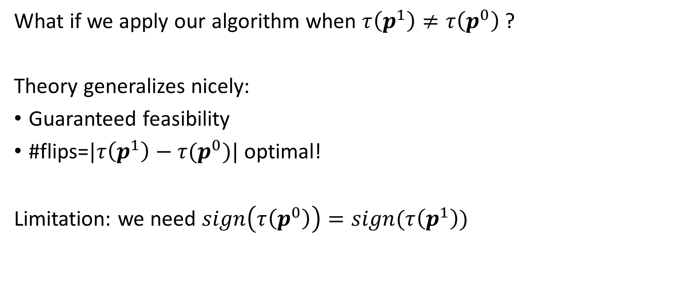
Curves with different turning number
What if we apply our algorithm when $τ\left(p^{1}\right)≠τ\left(p^{0}\right)$?
Theory generalizes nicely:
Guaranteed feasibility
#flips=$|τ\left(p^{1}\right)−τ(p^{0})|$ optimal!
Limitation: we need $sign\left(τ\left(p^{0}\right)\right)=sign(τ\left(p^{1}\right))$

Slide 46





Problem: Flips always occur at first vertex! (for angle-length also)
$$τ=2$$
$$τ=1$$

Slide 47

Results for unmodified algorithm

Slide 48


Solution: Automatic selection of “correct” flipping location.

Slide 49

Results with automatic flip location

Slide 50
THE END

Slide 51

Sketch of proof
Theorem: $p_{j}^{t}$ are $C^{∞}$ functions of $t$.
KKT conditions: The unique minimizers $L_{}^{t}$ satisfy $G(t,{L,ν)=0}_{}^{}$
Implicit function theorem: $t↦(L^{t},ν^{t})$ is smooth

Slide 52


Slide 53







Turning number
$$θ_{3}$$
$$\sum_{j=1}^{n}{θ_{j}=2πτ, τ∈ℤ}$$
$$θ_{4}$$
$$θ_{1}$$
$$θ_{5}$$
$$θ_{6}$$

Slide 54

Planar morphing problems
Morphing polygons Angle-length [Sederberg et al. 1993]
Morphing smooth curves Curvature interpolation
[Surazhsky and Elber 2002], [Saba et al. 2014]
Planar mesh morphing
Bounded distortion [Chen et al. 2013 ], ARAP [Alexa 2000]
[Chen et al. 2013 ]

Slide 55





Proof of feasibility theorem-sketch
$$∑θ_{j}^{t}=2πτ, ∀t∈[0,1]$$
Conical hull of
$$φ_{0}$$
$$φ_{0},φ_{1}$$
$$φ_{0},φ_{1},φ_{2}$$
$$φ_{0},φ_{1},φ_{2},φ_{3}$$

